Slide 1
SOFTWARE ENGINEERING (15B11CI513 ) Credits :- 4 Contact Hours :- 3-1-0

Slide 2
Course Outcomes
At the completion of the course, students will be able to:
COURSE OUTCOMES |  | COGNITIVE LEVELS
C314.1 | Explain software engineering principles and software process models for project development. | Remembering (Level 1)
C314.2 | Identify functional and non-functional requirements of a software project and design document software requirements specification. | Understand (Level 2)
C314.3 | Design, represent and document software requirements specification. Plan and execute activities for a software project. | Create (Level 6)
C314.4 | Apply UML modeling for software design from software requirements specification. | Apply (Level 3)
C314.5 | Analyze code checklist. Perform code Reviews, Code Refactoring, and Code optimization, design pattern | Analyze (Level 4)
C314.6 | Apply testing principles, develop and implement various manual and automated testing procedures, formal methods | Apply (Level 3)
C314.7 | Evaluate software in terms of general software quality attributes and possible trade-offs presented within the given problem. | Evaluate (Level 5)

Slide 3
Course Description
Module No. | Topics in the Module | No. of Lectures for the module
1. | Introduction to Software Engineering: Introduction to software engineering Principles, Software process models (build and fix model, waterfall model, Incremental process model, Evolutionary- Prototype and Spiral models, Agile Models (tools study), PSP, TSP, Software Reengineering. Project planning, Project Scheduling: network diagram, Gant Chart, CPM and PERT. | 7
2. | Requirement Engineering: Types of requirement, Requirement Elicitation, Analysis, Specification, SRS, Requirement Verification and Validation. | 4
3. | Software Design: Use case diagram, State diagram, Activity Diagram, Class Diagram, Sequence diagram, Collaboration diagram, Deployment Diagram, Component Diagram and Package diagram. Design Modularity: Coupling Cohesion. | 7
4. | Software Construction: Coding standards and guidelines, Code checklist, Code Reviews, Code Refactoring, Code optimization. Design pattern, Modern programming environments (Code search, Programming using library components and their APIs), Program comprehension; Program correctness, Defensive programming. | 8
5. | Software Metrics: Size-Oriented Metric, Function-oriented Metric, Halstead’s Software Metric, Information Flow Metric, Object-oriented Metric, Class-Oriented Metric, COCOMO Model. | 7
6. | Software Testing: White-Box Testing, Basis Path Testing, Control Structure Testing: Condition Testing, Data Flow Testing, Loop Testing, Black-Box Testing: Equivalence class partitioning, Boundary Value Analysis, Decision table testing, Cause effect graphing, Mutation Testing and regression Testing, formal methods. | 9
Total number of Lectures |  | 42

Slide 4
Recommended Reading material
Text Book(s):
1. | Roger S. Pressman, “Software Engineering: A practitioner approach”, Fifth Edition-TMH International .
2. | Sommerville , “Software Engineering” , Seventh Edition - Addison Wesley.
Reference Book(s):
3. | Grady Booch, James Rumbaugh, Ivar Jacobson, The Unified Modeling Language User Guide, Addison Wesley, Reading, Massachusetts, May 2005
4. | Richard Thayer , “Software Engineering Project Management”, Second Edition -Wiley-IEEE Computer Society Press.
5. | B. Bezier, “Software Testing Techniques”, Second Edition- International Thomson Computer Press.
6. | Pankaj Jalote, “An Integrated Approach to Software Engineering” Third addition , Springer Press

Slide 5
Evaluation Criteria
Components Maximum Marks
T1 20
T2 20
End Semester Examination 35
TA 25 (Assignments, Tutorial, Mini Project, Attendance)
Total 100

Slide 6
SOFTWARE ENGINEERING (15B11CI513 ) Module 1: Introduction to Software Engineering

Slide 7
Topics in Module 1
Introduction to software engineering Principles
Software process models
Build and fix model
Waterfall model
Incremental process model
Evolutionary
Prototype
Spiral models
Agile Models (tools study)
PSP, TSP
Software Reengineering
Project planning
Project Scheduling
Network diagram
Gant Chart
CPM
PERT.

Slide 8
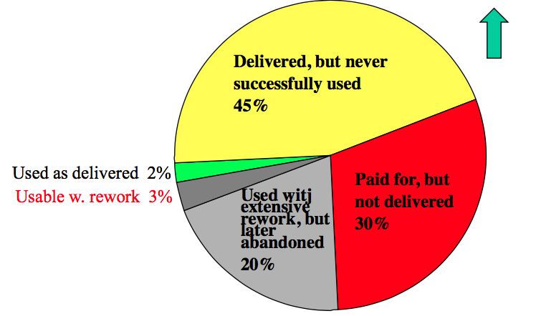
Why Software Engineering?
9 software projects totaling $96.7 million: Where The Money Went?

Slide 9
Scientist vs Engineer
Computer Scientist
Proves theorems about algorithms, designs languages, defines knowledge representation schemes
Has infinite time...
Engineer
Develops a solution for an application-specific problem for a client
Uses computers & languages, tools, techniques and methods
Software Engineer
Works in multiple application domains
Has only 3 months...
...while changes occurs in requirements and available technology

Slide 10
Software is Complex
Complex ≠ Complicated
Complex=composed of many simple parts
related to one another
Complicated = not well understood, or explained

Slide 11
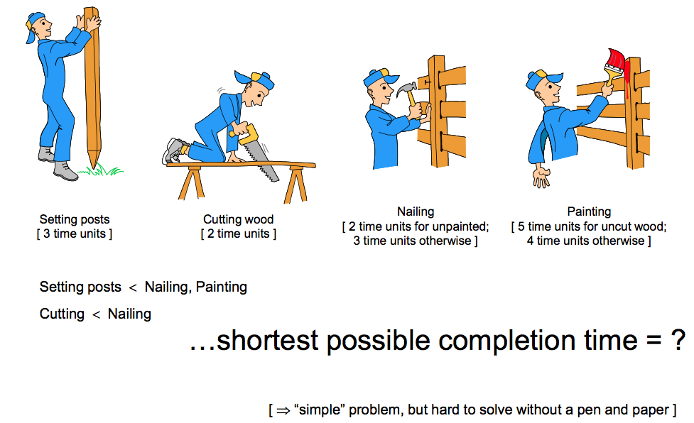
Complexity Example: Scheduling Fence Construction Tasks

Slide 12
Software Engineering: A Problem Solving Activity
Analysis: Understand the nature of the problem and break the problem into pieces
Synthesis: Put the pieces together into a large structure
For problem solving we use
Techniques (methods):
Formal procedures for producing results using some well-defined notation
Methodologies:
Collection of techniques applied across software development and unified by a philosophical approach
Tools:
Instrument or automated systems to accomplish a technique

Slide 13
Factors affecting the quality of a software system
Complexity: – The system is so complex that no single programmer can understand it anymore – The introduction of one bug fix causes another bug
Change:
– The “Entropy” of a software system increases with each change: Each implemented change erodes the structure of the system which makes the next change even more expensive (“Second Law of Software Dynamics”).
– As time goes on, the cost to implement a change will be too high, and the system will then be unable to support its intended task. This is true of all systems, independent of their application domain or technological base.

Slide 14
What is Software?
Software (IEEE) is a collection of
– programs, – procedures, – rules, and – associated documentation and data

Slide 15
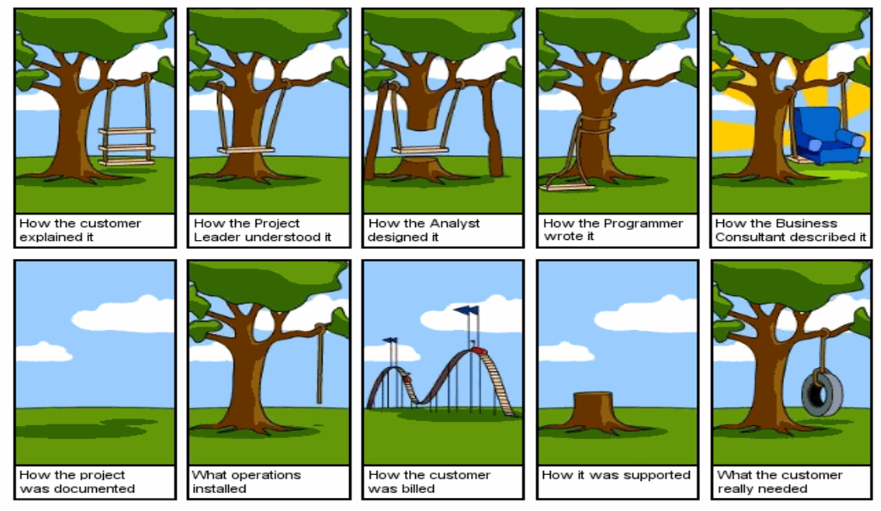
The Software Challenge

Slide 16
Software Engineering: Definition
Software Engineering is a collection of techniques, methodologies and tools that help with the production of – a high quality software system
– with a given budget – before a given deadline
while change occurs.

Slide 17
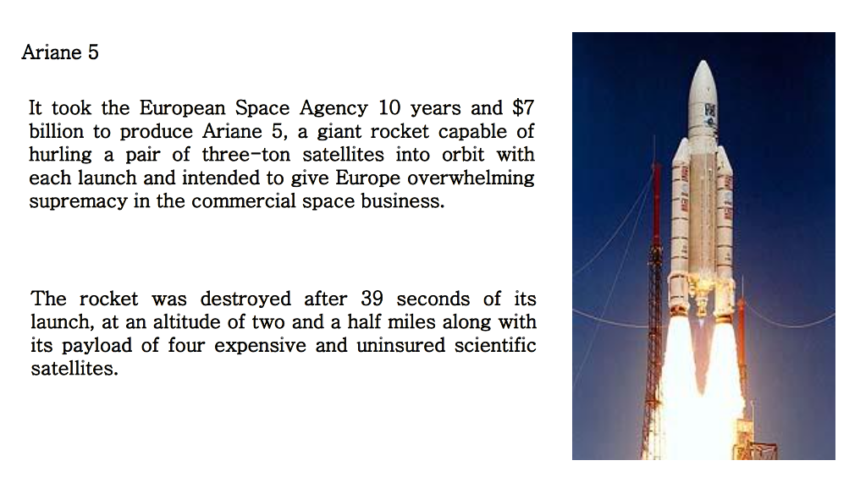
Some Software failures

Slide 18
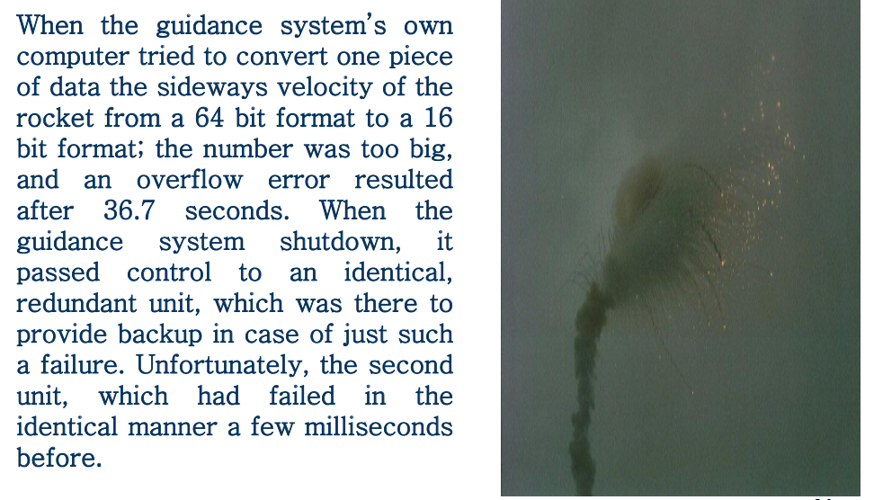
Some Software failures (cont…)

Slide 19
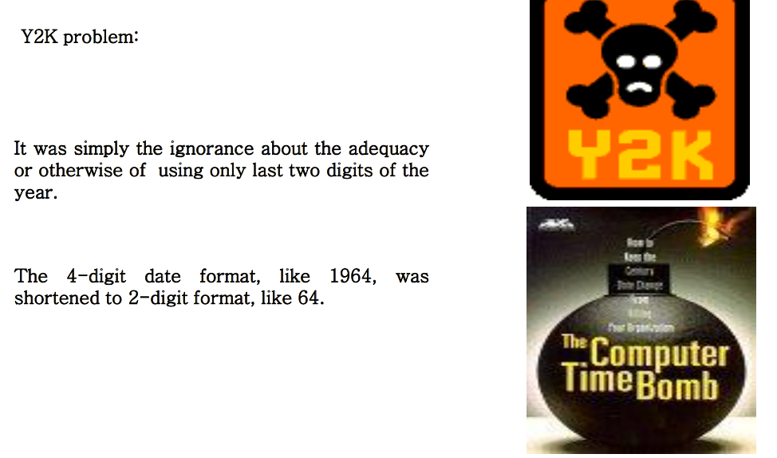
Some Software failures (cont…)

Slide 20
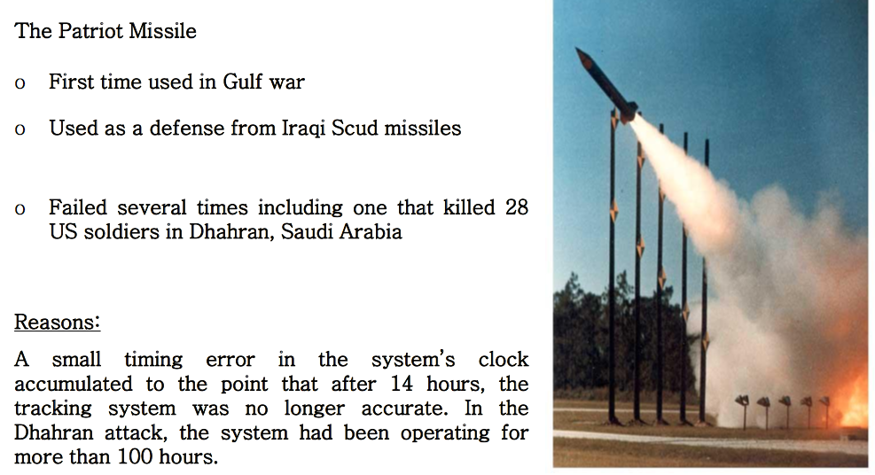
Some Software failures (cont…)

Slide 21
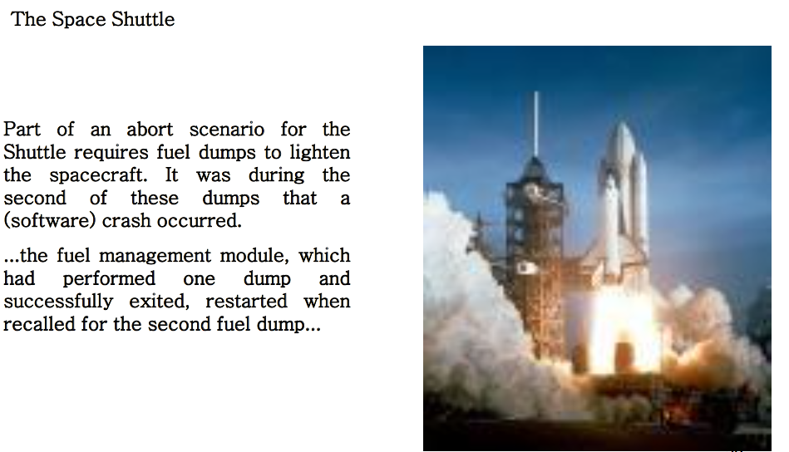
Some Software failures (cont…)

Slide 22
Some Software failures (cont…)
A simple fix took care of the problem...but the programmers decided to see if they could come up with a systematic way to eliminate these generic sorts of bugs in the future. A random group of programmers applied this system to the fuel dump module and other modules.
Seventeen additional, previously unknown problems surfaced!

Slide 23
Some Software failures (cont…)
Financial Software
Many companies have experienced failures in their accounting system due to faults in the software itself. The failures range from producing the wrong information to the whole system crashing.

Slide 24
Some Software failures (cont…)
Windows XP
Microsoft released Windows XP on October 25, 2001.
On the same day company posted 18 MB of compatibility patches on the website for bug fixes, compatibility updates, and enhancements.
Two patches fixed important security holes.
This is Software Engineering.

Slide 25
Software Applications
• System software • Application software • Engineering/scientific software • embedded software • Product-line software • WebApps (Web applications) • AI software

Slide 26
Software—New Categories
• Open world computing—pervasive, distributed computing
• Ubiquitous computing—wireless networks
• Netsourcing—the Web as a computing engine
• Open source—”free” source code open to the computing community
• Data mining • Grid computing • Cognitive machines • Software for nanotechnologies

